Slide 1
Fighting or Accepting Nonresponse: Considerations and Plans at Statistics Canada
Joint Statistical Meetings
August 3-8, 2024
Portland, Oregon
Eric Rancourt

Slide 2
Overview
Increasing nonresponse
Survey context
Issues and traditional counter measures
Fighting or accepting nonresponses
The importance of assumptions
Considerations and plans at Statistics Canada
1

Slide 3
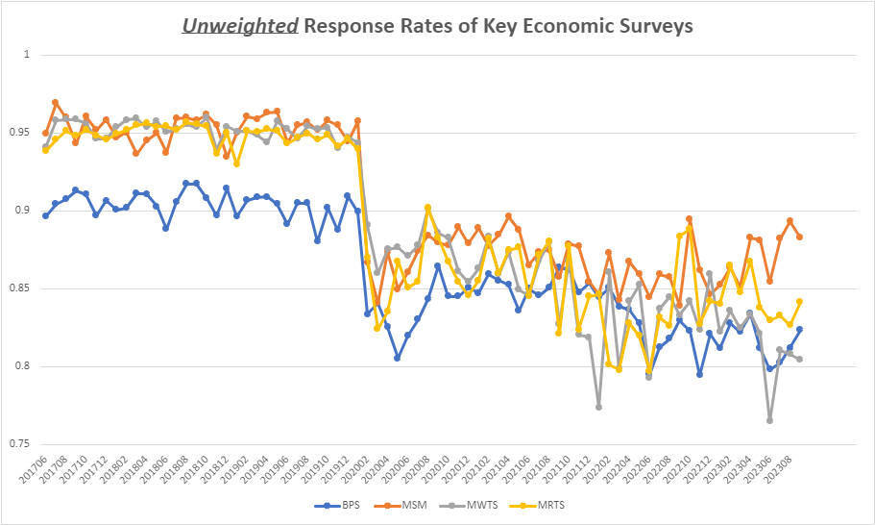
Response Rates for some of Statistics Canada’s Economic Surveys
Notes:
SDMX: Statistical Data and Metadata eXchange aims to standardize and modernize the mechanisms and processes for the exchange of statistical data and metadata among international organizations and member countries.

Slide 4
Response Rates for some of Statistics Canada's Household Surveys
Notes:
SDMX: Statistical Data and Metadata eXchange aims to standardize and modernize the mechanisms and processes for the exchange of statistical data and metadata among international organizations and member countries.

Slide 5
Survey Context
Response rates have been on a downward trend
COVID-19 exacerbated the situation
The demand for (detailed) information keeps on rising
Survey capacity has a practical limit
Confidentiality protection will remain important
2

Slide 6
Issues
Obtaining responses
(refusals, reaching, connecting)
Capacity given demand to collect
(workforce, collection period, size of questionnaires)
Capacity to disseminate
(confidentiality, empty cells, ethics)
3

Slide 7
Designing Surveys then (When the Response Rate was high)
1) Avoiding Bias:
  Randomized selection
  Nonresponse negligible
  __________________________________________
  Effective sample meets both
2) Reducing variance:
  Large enough samples
  Calibrate where possible
  ________________________________
  Effective sample meets both
Bias was contained, worries were about variance (and CVs)
Error = BIAS² + Variance
Notes:
SDMX: Statistical Data and Metadata eXchange aims to standardize and modernize the mechanisms and processes for the exchange of statistical data and metadata among international organizations and member countries.

Slide 8
Designing Statistical Programs Surveys (Now)
1) Avoiding Bias:
  Randomized selection
    Surveys: “Only respondents”
    Alternative data: Not random
  Nonresponse negligible
  __________________________________________
  Effective sample meets both
2) Reducing variance:
  Large enough samples
  Calibrate where possible
  ________________________________
  Effective sample meets both
Error = BIAS² + Variance
Notes:
SDMX: Statistical Data and Metadata eXchange aims to standardize and modernize the mechanisms and processes for the exchange of statistical data and metadata among international organizations and member countries.

Slide 9
Understanding and Countering Error
These 3 points are true for any data gathering method! Surveys, admin data, other types of data, crowdsoucing, etc.
Error is a function of (Meng, 2018):
1) The Relation between topics & being in-sample
2) The GAP between in- & out-of-sample units
3) The Variability of the data
Notes:
SDMX: Statistical Data and Metadata eXchange aims to standardize and modernize the mechanisms and processes for the exchange of statistical data and metadata among international organizations and member countries.

Slide 10
What has been done?
Increasing samples sizes
Oversampling some areas / characteristics
More footnotes in publications to explain limitations
Increased efforts in collection teams to maximize response rates
➔All these are within traditional survey designs
6

Slide 11
What has been done?
Modernization of Statistics Canada (2017):
  Statistical Capacity Building and Leadership
  Sharing and Collaboration
  User-Centric Service Delivery
  Leading-Edge Methods and Data Integration
  Modern Workforce and Flexible Workplace
Adopted an Admin-First strategy (Rancourt, 2018)
Surveys still needed, nonresponse continuing to decline
4

Slide 12
Fighting or Accepting Nonresonse?
When to really make the turn?
When response rates are below 50%? Below 33%? 25%?...
When demand significantly exceeds capacity?
When receiving signals from users?
➔Urgency to get tomorrow’s (and today’s!) approaches ready to support more sustained stretching and possible shocks (current approaches not sustainable, NASEM report 2023)
7

Slide 13
Assumptions
As response rates diminish, dependency on assumptions increases
Assumptions = Model
e.g. E(${\overline{y}}_{Sr})$= E(${\overline{y}}_{Snr}$) (=E(${\overline{y}}_{S}$))
➔Models are used and need to be used even more
➔Assumptions have to be validated
9

Slide 14
Validating Assumptions
1) Attempting to make assumptions valid by design (Responsive designs: Groves and Heeringa, 2006)
2) Attempting to validate assumptions and perhaps even correct (Subsampling: Hanson and Hurwitz, 1946)
(Audit sampling: Zhang, 2019)
3) Designing surveys/programs to improve the use of models (“Design-optimized priors”: Rao and Ghangurde, 1972)
10

Slide 15
Validating Assumptions
1) Attempting to make assumptions valid by design (Responsive designs: Groves and Heeringa, 2006)
2) Attempting to validate assumptions and perhaps even correct (Subsampling: Hanson and Hurwitz, 1946)
(Audit sampling: Zhang, 2019)
3) Designing surveys/programs to improve the use of models (“Design-optimized priors”: Rao and Ghangurde, 1972)
10

Slide 16
Subsampling Non-respondents
To corroborate survey results;
To signal areas of discrepancies;
To inform analysts, and users;
To provide the means to adjust designs temporarily or to redesign
To enrich the set of training data for machine-learning (to avoid bias, data drift)
To provide the means to build an admin-survey integrated design (file-sample could/should overlap)
To set the stage for more methods
12

Slide 17
Examples (or related programs in place)
Survey of Employment, Payrolls and Hours
  Admin file with a small survey to compute model parameters
Census Undercoverage Studies
  Survey (census) with admin data and a survey to find units not covered
➔Both are adjusting for reality departing from assumptions of similarity between in-file/in-sample and others
18

Slide 18
Developments at Statistics Canada
Reduced sample size with an added survey of non-respondents
  To validate results from the main survey
  To adjust estimates
  To signal areas where the sample may need to be re-increased until modeled adequately (quality control about the design)
Methodological improvements
  To reduce the number of design stages
  To reduce collection frequency
  To further optimize collection
20

Slide 19
Thank you!
Eric Rancourt
Statistics Canada
Eric.Rancourt@Statcan.gc.ca
Cette présentation est disponible en français sur demande

Slide 20








Stay connected!
StatsCAN app
Eh Sayers podcast
StatsCAN Plus
The Daily
Website
Surveys and statistical programs
Data service centres
My StatCan
Questions? Contact us: infostats@statcan.gc.ca

Slide 21



Statistics Canada—
Your National Statistical Agency
Delivering insight through data for a better Canada

